Slide 1




Critical Thinking S1 2023
Dr. Iwan Williams
Email: iwan.williams1@monash.edu

Slide 2
Lecture 8.1
Arguments for causation

Slide 3
Review quiz!

Slide 4
Causal Claims
A causal claim is a statement about WHY something happens, linking cause and effect.
Smoking causes lung cancer.
Youth unemployment is at an all time high because millennials are lazy.
An apple a day keeps the doctor away!
I started going to a tutor so my grades are improving.
Two kinds of causal claim:
Specific causal claims
About specific events (e.g. “I flicked the switch which turned the light on”).
Causal generalisations
About general categories of events (e.g. “Smoking causes cancer”).

Slide 5
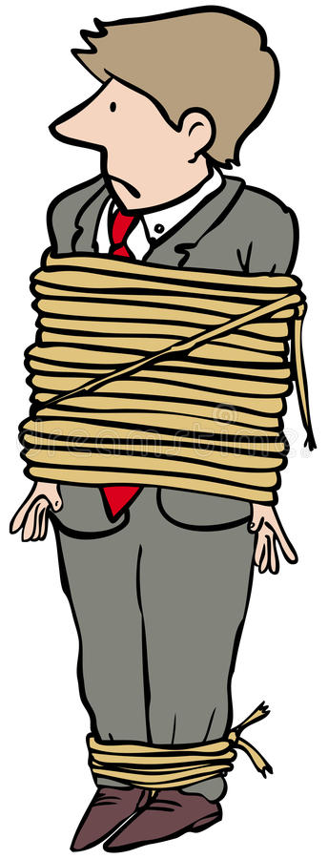
Why do we care about causal claims?
Attribution of praise/blame
Interventions to change the world
Notes:
Smith and Hallet: if Smith did indeed cause the death of Hallet, then Smith needs to held to account. If your tutor really did cause an improvement in your grades, then we can praise them.
Intervening to change the world: human beings are highly effective at changing conditions in the world – and in order to do this we need to understand the causal structure of the world; i.e., what causes what.

Slide 6
A common confusion about causes
Causes are not necessary and sufficient conditions!
When we say “smoking causes lung cancer” we’re not saying
All smokers develop lung cancer
Smoking is the only thing that causes lung cancer (i.e. all people with lung cancer are smokers)
Rather we’re saying:
Increasing your exposure to cigarette smoke is one way of increasing your chance of developing lung cancer, and…
Decreasing your exposure to cigarette smoke is one way of decreasing your chance of developing lung cancer
Causes are ‘knobs and dials’ – i.e. factors that can in principle be used to bring about changes in the world.
Notes:
We’ve spoken a fair bit about necessary and sufficient conditions.
People tend to make the mistake of thinking about causal relationships in terms of necessary and sufficient conditions. So, they think that if A causes B, it must be the case then whenever A happens, B must also happen. And, whenever B happens, A must have caused it.
Causes do not work like this! E.g. smoking causes lung cancer, but not all smokers develop lung cancer. Nor is it the case that all people with lung cancer are smokers. Hence, smoking is not a necessary and sufficient condition for developing lung cancer, but nonetheless smoking certainly is a cause of lung cancer.
Knobs and dials: increasing the amount of cigarettes you smoke is a way of increasing your chance of developing lung cancer. Decreasing your exposure to cigarette smoke is a way of decreasing your chance of developing lung cancer.
Necessary condition: “Air is necessary for human life/without air human beings die.” A is a necessary condition for B because without A we cannot have B. “while air is a necessary condition for human life, it is by no means a sufficient condition, i.e. it does not, by itself, i.e. alone, suffice for human life. While someone may have air to breathe, that person will still die if s/he lacks water (for a number of days), has taken poison, is exposed to extremes of cold or heat, etc.”
Sufficient condition: A condition A is said to be sufficient for a condition B, if (and only if) the truth (/existence /occurrence) [as the case may be] of A guarantees (or brings about) the truth (/existence /occurrence) of B.
e.g. cooking eggs: it is guaranteed that if I boil eggs, I will cook them. So, it is sufficient for me to boil eggs to cook them. But I could also fry the eggs, or poach them, or steam them, or I could leave them on the dashboard of my car on a 45 degree day… they are all sufficient to cook eggs, none of them are necessary.
Necessary and Sufficient condition example: “David's being a father is both a necessary and a sufficient condition for his being a male parent."

Slide 7
Why are we bad at identifying causes?
Notes:
We’re overzealous, we see causal relationships where they don’t exist

Slide 8
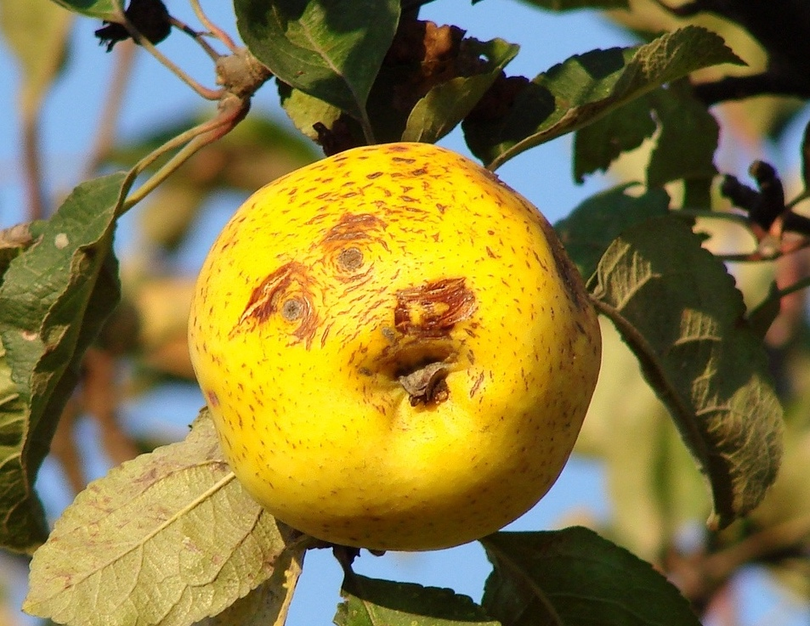
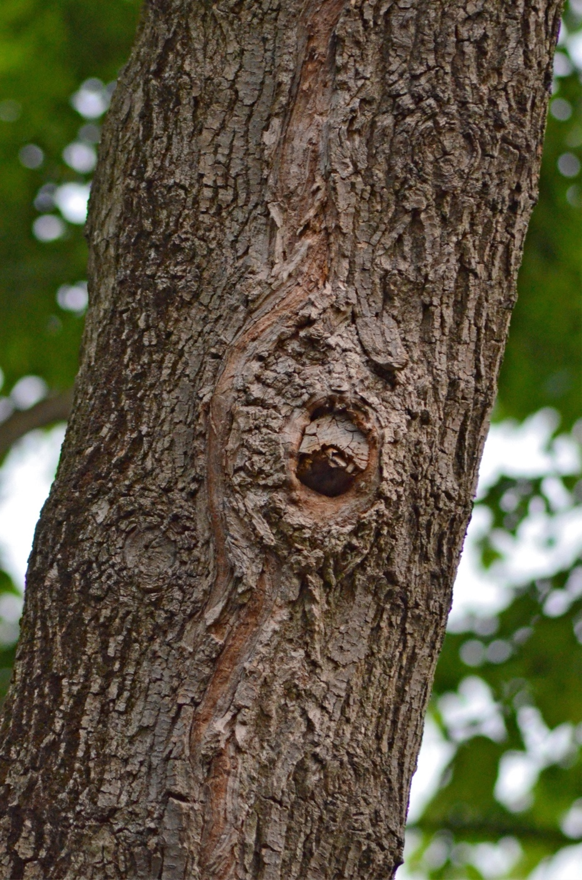
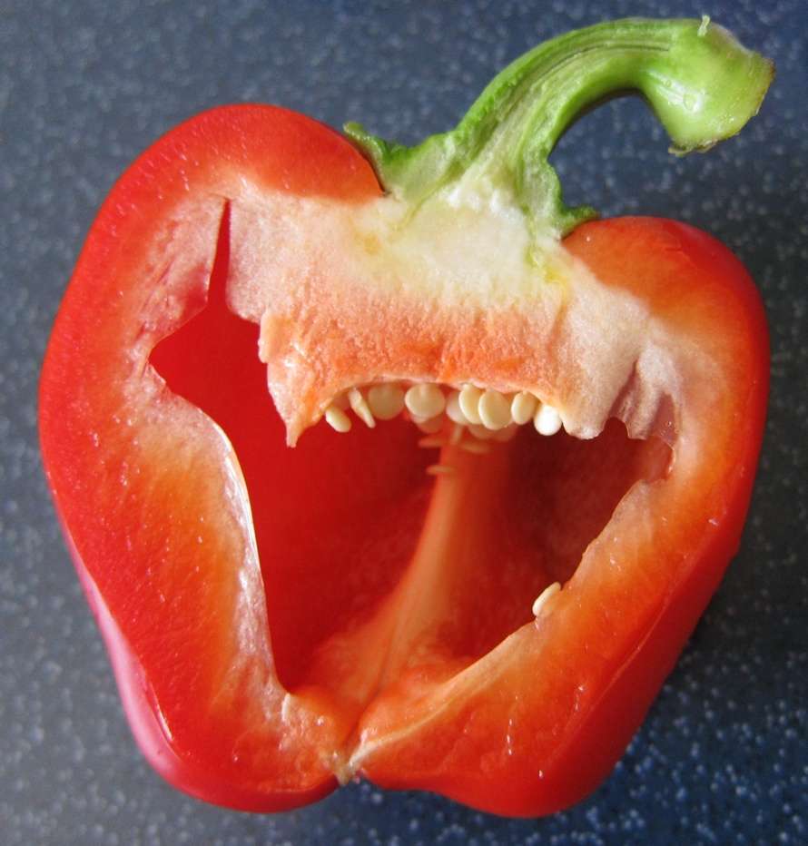
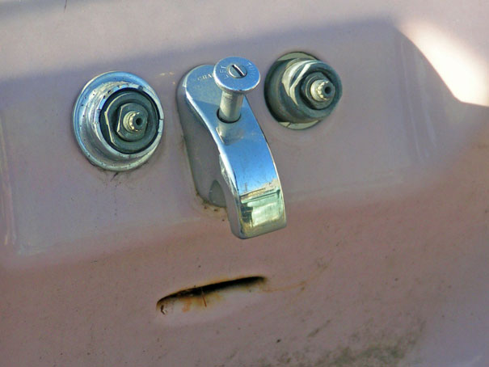
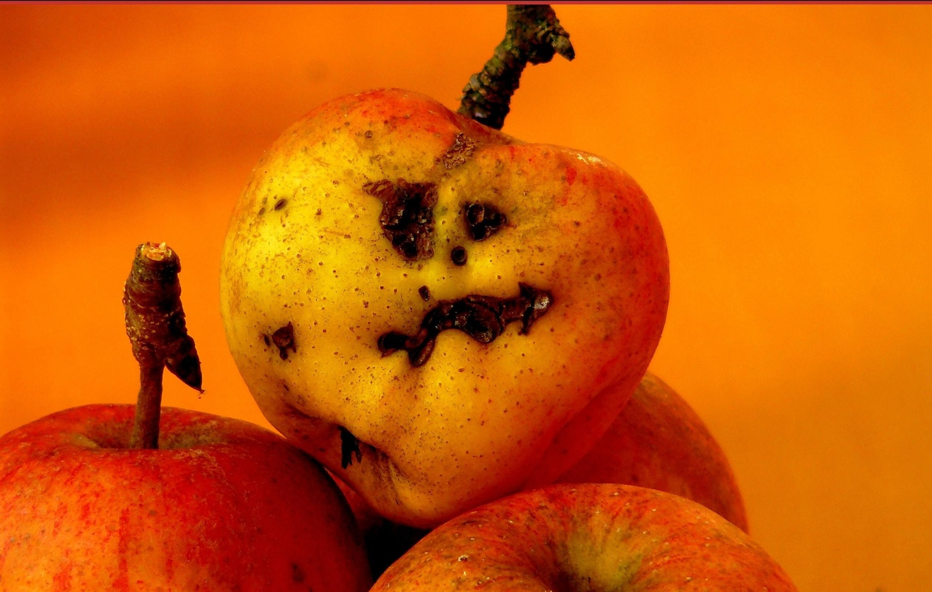


Slide 9
Causes precede their effects
If A caused B then A happened before B
Examples!
I took the painkiller and my headache went away.
I didn’t water my pot plants and then they died.
I drank a bottle of whisky and then I felt a little funny.
…
Notes:
The pattern is; if A caused B then A happened before B.
Causes precede their effects. If A caused B, then it must be the case that A happened before B.

Slide 10
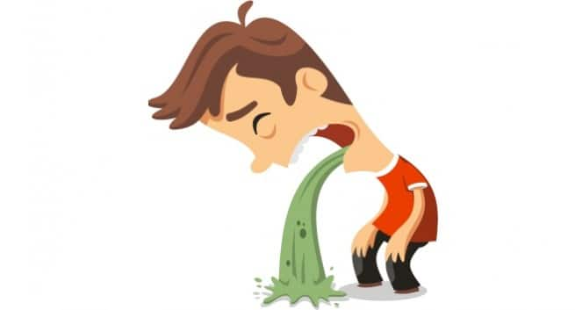
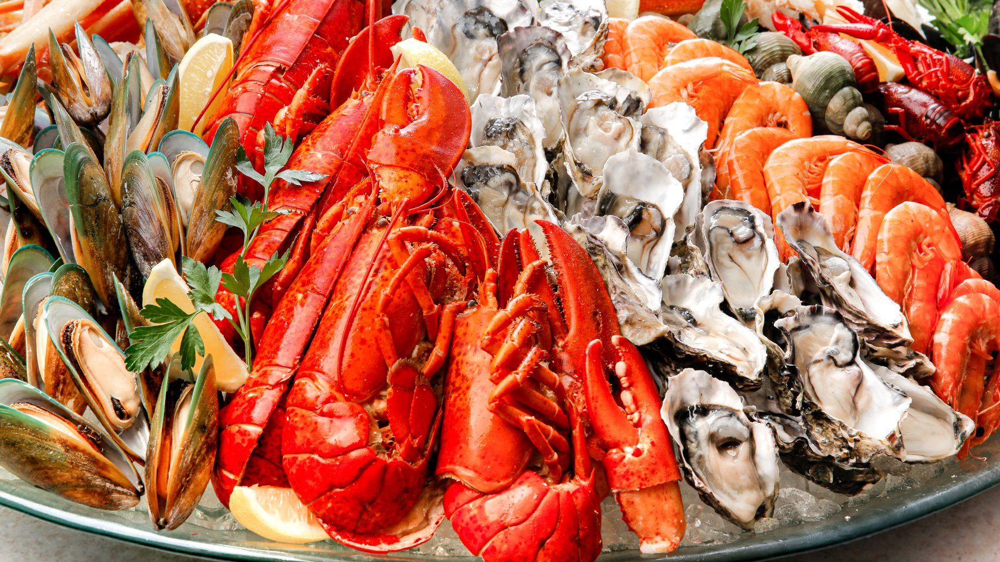
Post-hoc fallacy
A happened and then B happened later
Therefore,
C: A caused B
Notes:
Say I go out to dinner with friends, seafood buffet, and then I get sick 2 hours later. Naturally, I blame the seafood.
However, none of my friends got sick, so my inference may not be reliable! Just because I ate the seafood and then got sick does not yet establish that the seafood was the cause.

Slide 11
Post-hoc fallacy
A happened and then B happened later.
Therefore,
C. A caused B.
Counter examples!
The rooster crowed and then the sun came up. Therefore, the rooster caused the sun to rise.
Our soccer team was losing until I bought new shoes. My lucky shoes are winning us the league!
…
Notes:
In these cases we do not have good evidence for a causal link between event A and event B. For instance, if A is the new shoes and B is winning all subsequent soccer games, where is the evidence here that A has causes B? It could be the case that the team has a new coach, or that some injured players who are particularly good have returned to health and games. Or that the teams you played against after the shoe purchase were less skilled, or perhaps you’re neglecting the base rate! Something we’ll discuss in video 3.
So, how do we establish causal claims? General argument form is like this….

Slide 12
How do we establish specific causal claims?
A happened and then B happened later.
The best explanation of this is that A caused B.
Therefore,
C. A caused B.
I ate seafood and then got sick.
The best explanation of this is that eating the seafood caused me to get sick.
Therefore,
C. Eating the seafood caused me to get sick
Notes:
This is a form of inference to the best explanation. This is an inductive argument.

Slide 13
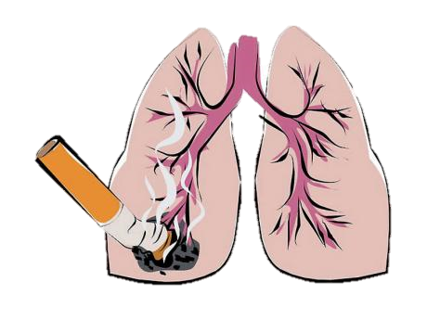
How do we establish causal generalisations?
Smoking and lung cancer are correlated.
Therefore,
C. Smoking causes lung cancer.

Slide 14
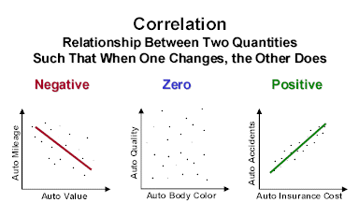
What is correlation?
Notes:
Correlation: relationship btwn two variables such that when one changes, the other does too.
We’ll look at this in more detail in the next video.

Slide 15
How do we establish causal generalisations?
Smoking and lung cancer are correlated.
Therefore,
C. Smoking causes lung cancer.
Notes:
The proportion of smokers with lung cancer is higher than the proportion of non-smokers with lung cancer.

Slide 16


How do we establish causal generalisations?
Ice-cream consumption and shark attacks are correlated.
Therefore,
C. Ice-cream consumption causes shark attacks.

Slide 17

Correlation is not sufficient for causation!

Slide 18
A being a cause of B is only one of the possible explanations for the fact that A and B correlate.

Slide 19
How do we establish causal generalisations?
A and B are correlated.
The best explanation of this correlation is that A causes B.
Therefore,
C. A causes B.
Smoking and lung cancer are correlated.
The best explanation of this correlation is that smoking causes lung cancer.
Therefore,
C. Smoking causes lung cancer.
Notes:
This is a form of inference to the best explanation. This is an inductive argument.

Slide 20
Arguments for causal generalisations
A and B are correlated.
The best explanation of this correlation is that A causes B.
Therefore,
C. A causes B.
Two things we can challenge:
Are A and B actually correlated?
Is the correlation actually best explained by A causing B?

Slide 21
Arguments for causal generalisations
A and B are correlated.
The best explanation of this correlation is that A causes B.
Therefore,
C. A causes B.
Two things we can challenge:
Are A and B actually correlated?
Is the correlation actually best explained by A causing B?

Slide 22
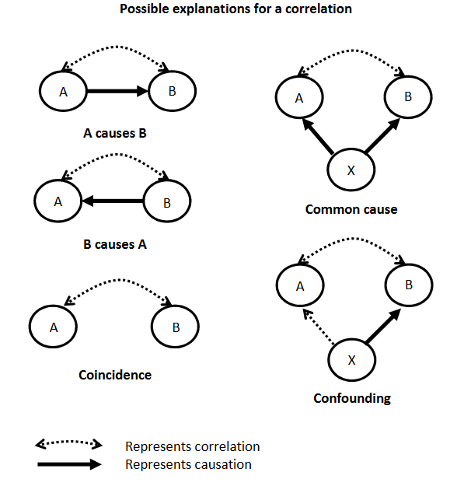

Smoking is positively correlated with incidence of lung cancer, because smoking causes lung cancer.
Notes:
If you do have a causal relationship, you will definitely have a correlation!!
Smoking causes lung cancer, there’s going to be a positive correlation between incidences of lung cancer and smoking.

Slide 23
But there are four other possible explanations for a correlation
A
B

Slide 24

Ice-cream consumption is positively correlated with shark attacks, but doesn’t cause shark attacks.
Notes:
Ice-cream consumption reliably co-occurs with shark attacks; i.e. there is a positive correlation between ice-cream consumption and shark attacks.
As ice-cream sales increase, so too do shark attacks; does this mean that ice-cream consumption causes shark attacks??
No! A causal relation between ice-cream consumption and shark attacks does not best explain their correlation.
Common cause: third variable causes both shark attacks and an increase in ice-cream consumption. In this case, the common cause is going to be something like warm weather.
As weather gets warmer, we get more people swimming in the ocean (lead to more shark attacks), and more people buying and eating ice-cream.
The correlation between ice-cream consumption and shark attacks can be explained by the common cause of warm weather.

Slide 25
Ice-cream consumption is positively correlated with shark attacks, but doesn’t cause shark attacks.

Slide 26
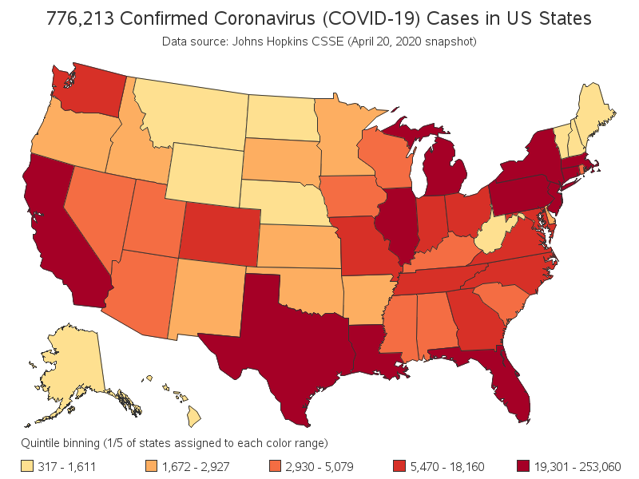
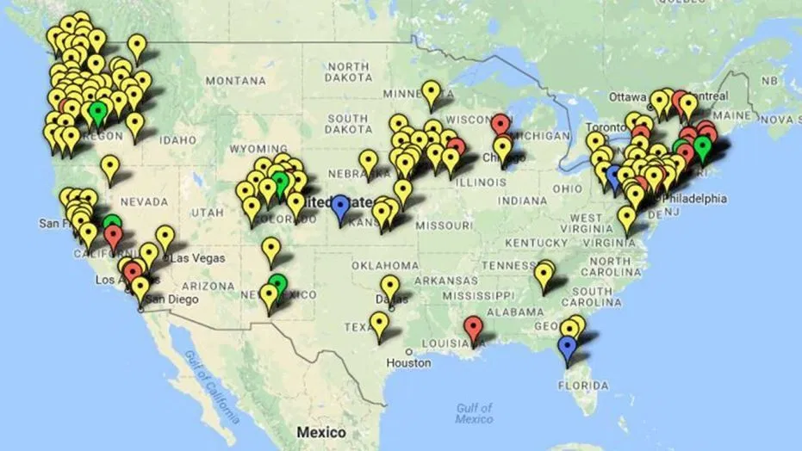
Refugee resettlement is correlated with Corona Virus in US, but not a cause of Corona Virus infection.
PNP News
Refugee settlement/ illegal immigration
COVID-19 cases
Population (density)
(Map of sanctuary cities)
Notes:
April 2020 – refugee resettlements are correlated with COVID-19 infection rates in the USA. Map of covid infection rates in April 2020, map of sanctuary cities (resettlement programs for refugees).
Questionable news program highlighted the correlation between cities/states with resettlement programs for refugees and cities/states with high COVID-19 infection rates. They then said that this correlation was evidence that refugees caused increased infection rates of COVID-19.
In this case, there is a confounding variable! A confounding variable is a variable that is causally related to one of the correlated pair, but only correlated to the other of the pair. The confounding variable is population density – this variable causes increased rates of infection and, is correlated with sanctuary cities (i.e. sanctuary cities happen to be cities with high population density).

Slide 27
Refugee resettlement is correlated with Corona Virus in US, but not a cause of Corona Virus.
PNP News
Refugee settlement
COVID-19 cases
Population (density)
(Map of sanctuary cities)
Notes:
It is true the refugee resettlement in the US is positively correlated with the COVID virus, this correlation is not evidence that refugees cause increased covid infections.
Rather, the correlation is explained by a confounding variable!

Slide 28
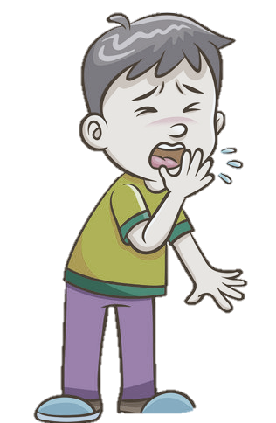
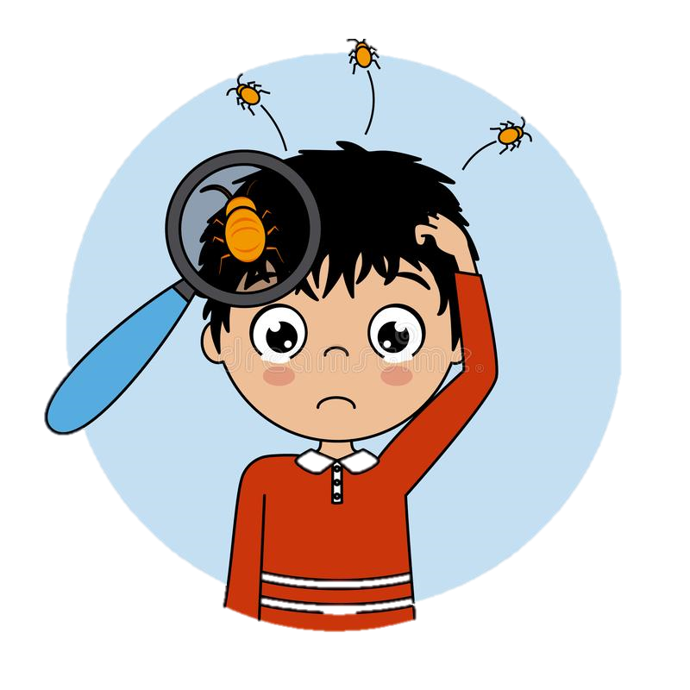
Headlice are anti-correlated with health, but they don’t cause you to be healthy.
Healthy typically had headlice
Sick typically had no headlice
Notes:
In middle-ages, people noticed that having head lice is anti-correlated with health. That is, typically, healthy people have headlice, whilst sick people typically did not have head lice.
Found a strong negative correlation between being healthy and having headlice.
Head lice does not cause you to be healthy. Rather, being unhealthy causes headlice to leave! Head lice are very sensitive in changes to bodily function & temperature, when they notice that you are sick they abandon you and go to find a healthy host.

Slide 29
Headlice are anti-correlated with health, but they don’t cause you to be healthy.
Healthy typically had headlice
Sick typically had no headlice
Notes:
In middle-ages, people noticed that having head lice is anti-correlated with health. That is, typically, healthy people have headlice, whilst sick people typically did not have head lice.
Head lice does not cause you to be healthy. Rather, being unhealthy causes headlice to leave! Head lice are very sensitive in changes to bodily function & temperature, when they notice that you are sick they abandon you and go to find a healthy host.
This is a case of B causing A, reverse causation!

Slide 30
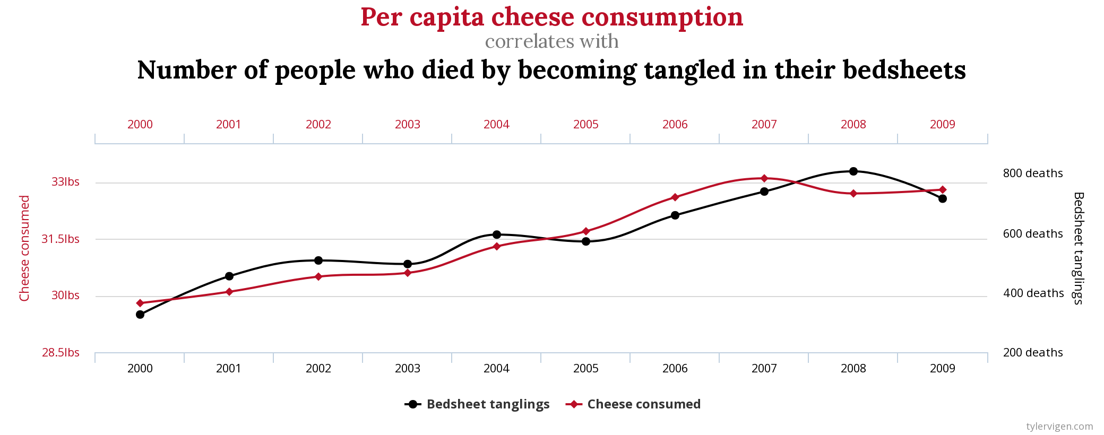
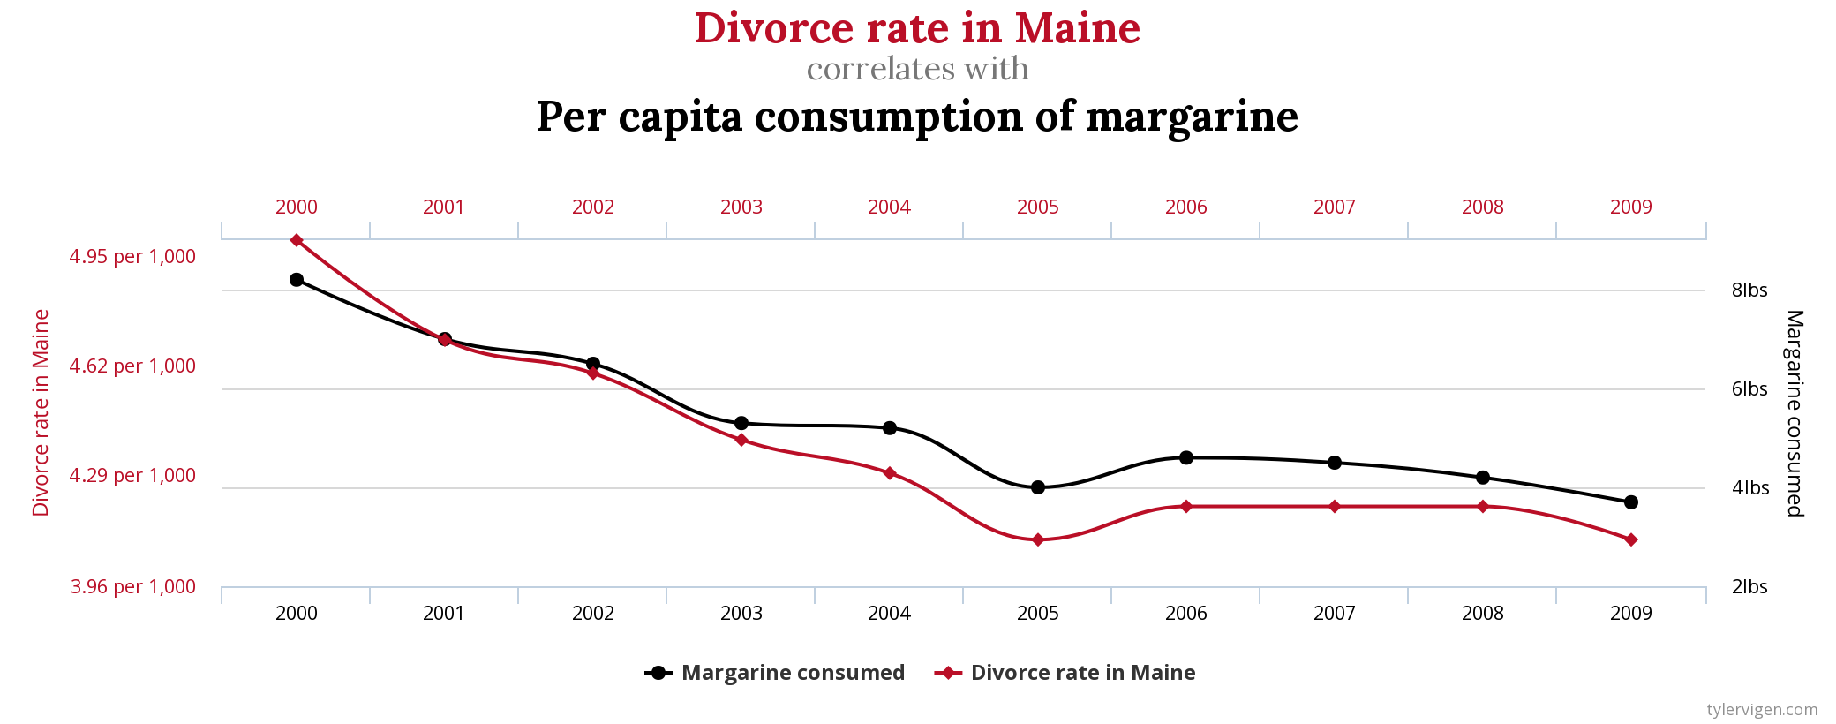
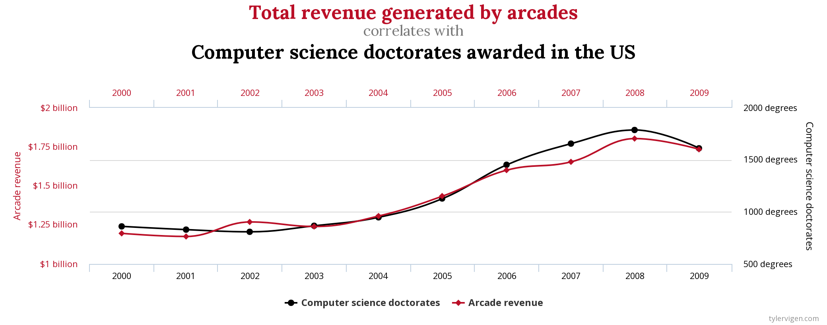
Some correlations are just coincidence
http://www.tylervigen.com/spurious-correlations

Slide 31
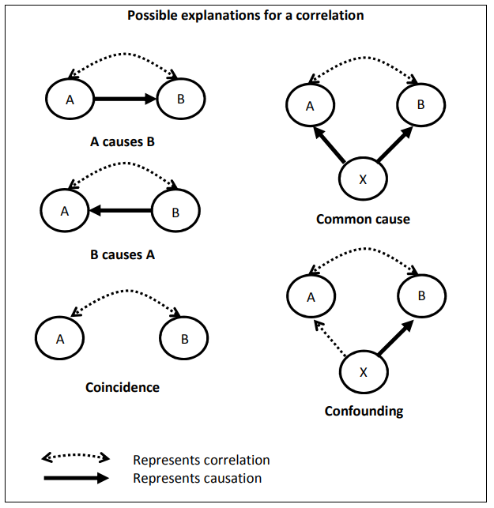

Alternative explanations for a correlation
Notes:
But remember, causes aren’t necessary conditions.
If smoking correlates with cancer, you can’t disprove that smoking causes cancer by simply pointing out that other things cause cancer.
You would have to show that the correlation between smoking and cancer was better explained by something else.
(In this case, you won’t find such an explanation – the best explanation is that smoking causes cancer).

Slide 32
Arguing for causal claims
Argument for specific causal claim
A happened and then B happened later.
The best explanation of this is that A caused B.
Therefore,
C. A caused B.
Argument for causal generalisation
A and B are correlated.
The best explanation of this correlation is that A causes B.
Therefore,
C. A causes B.
A happened and then B happened later.
Therefore,
C. A caused B.
A and B are correlated.
Therefore,
C. A causes B.
Post Hoc Fallacy!
Correlation is not sufficient for causation!

Slide 33
How do we establish causal generalisations?
1. A and B are correlated.
2. This correlation is best explained if A causes B.
Therefore,
C. A causes B.
Can the correlation be better explained by:
A common cause?
A confounding variable?
Reverse causation?
Chance?

Slide 34
Lecture 8.2
Is there even a correlation?

Slide 35
Arguments for causal generalisations
A and B are correlated.
The best explanation of this correlation is that A causes B.
Therefore,
C. A causes B.
Two things we can challenge:
Are A and B actually correlated?
Is the correlation actually best explained by A causing B?

Slide 36
Arguments for causal generalisations
A and B are correlated.
The best explanation of this correlation is that A causes B.
Therefore,
C. A causes B.
Two things we can challenge:
Are A and B actually correlated?
Is the correlation actually best explained by A causing B?

Slide 37
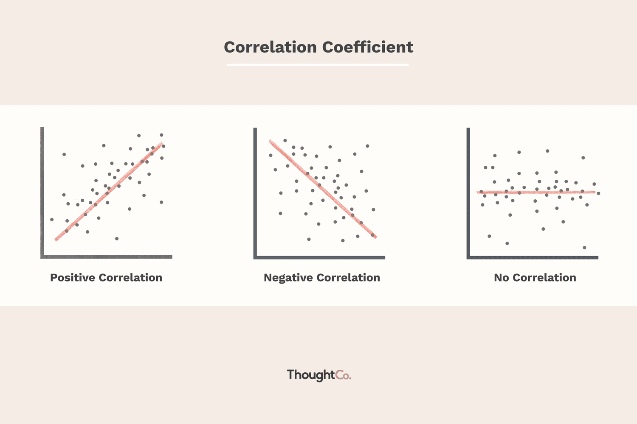
Correlations
There is a (positive) correlation between A and B when B is more likely to occur if A occurs than if A does not occur.
Or in other words…
The proportion of As which are B is greater than the proportion of non-As which are B.
e.g.
you are more likely to catch a cold in winter than in summer.
the proportion of smokers with lung cancer is higher than the proportion of non-smokers with lung cancer.
Notes:
Claims about correlation are statistical generalisation!
Strictly speaking they are comparisons between two statistical generalisations – (1) a statistical generalisation about a class of things with some property and (2) a statistical generalisation about the class of things which lack that property.

Slide 38
Correlations
There is a negative correlation between A and B when B is less likely to occur if A is occurs than if A does not occur.
Or in other words
The proportion of As which are B is smaller than the proportion of non-As which are B.
e.g.
you are less likely to do well on assignments if you don’t come to tutorials.
the proportion of yoga practitioners with heart disease is lower than the proportion of non-yoga practitioners with heart disease.

Slide 39
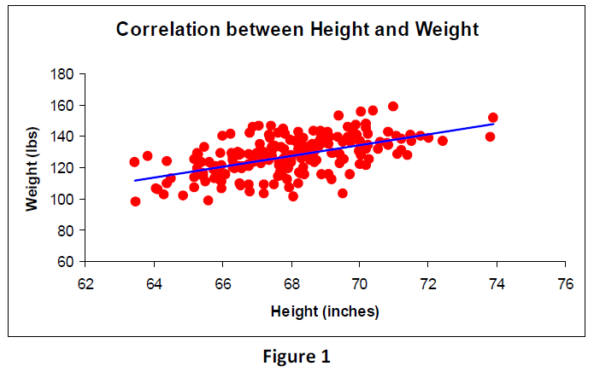
Correlations
Correlation between quantities
There is a positive correlation between the quantities A and B when individuals with higher values of A are more likely to also have higher values of B.
There is a negative correlation between the quantities A and B when individuals with higher values of A are more likely to have lower values of B.
Notes:
values/degrees/amounts

Slide 40
Illusory correlations - Regression to the mean
Notes:
Apparent correlation – is it better explained by regression to the mean.

Slide 41
You are the mayor of a city. You want to show you’ve been effective against traffic accidents.
Notes:
Suppose you find the intersection that had the very worst rate of accidents this year. The average is 25 but this year it had 70 traffic accidents.
Then you install an intervention (traffic camera, altered light pattern, extra signs).
Chances are the following year the rate of accidents will go down, even if the intervention has no effect!
That is, there has been a regression to the mean – this year’s number was atypically high, next year its likely it will be closer to the average.

Slide 42
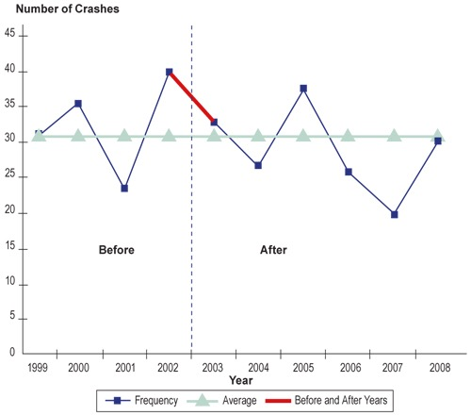
Notes:
If we zoom out and look at the longer term, we might see that there is actually no correlation between the presence of the traffic camera at the intersection and the number of crashes.

Slide 43
Illusory correlations - Neglecting the base rate

Slide 44
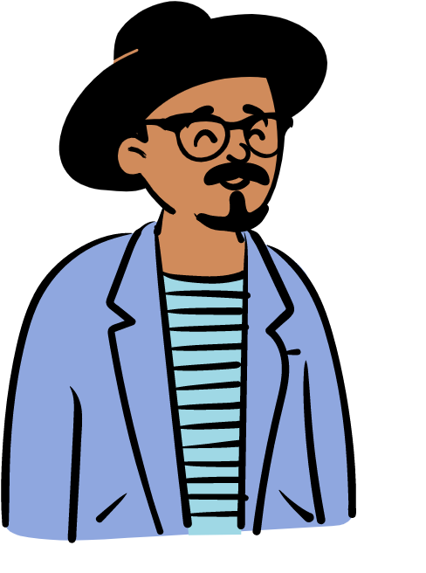
Suppose we only ever see Bob when it’s sunny out. And 70% of the time he’s wearing a hat. Can we conclude that there’s a correlation between Bob’s waring a hat and it being sunny?
No! What if Bob wears a hat 70% of the time no matter the weather!
 | Wearing a hat | Not wearing a hat
Sunny | 70% | 30%
We’ve neglected the base rate at which Bob wears hats.
Notes:
Base rate = background or prior probability of something occurring, whether or not the property of interest is present.
What if Bob wears a hat 70% of the time no matter the weather? Then, it being sunny is irrelevant. Does it being sunny provide any predictive leverage for Bob wearing a hat? This may not be the case. A correlation should provide predictive leverage.
What is the probability of Bob wearing a hat if its not sunny? That’s what we need to consider to establish a correlation.

Slide 45
Remember, to say there is a positive correlation between A and B is to say that B is more likely to occur if A occurs than if A does not occur.
 | Probability of Bob wearing a hat | Probability of Bob not wearing a hat
Sunny | 70% | 30%
Not Sunny | 0% | 100%
Notes:
Now we have a correlation.

Slide 46
Lesson 8.3
Controlled experiments

Slide 47
Arguments for causal generalisations
A and B are correlated.
The best explanation of this correlation is that A causes B.
Therefore,
C. A causes B.
Scientists have developed one way of determining whether both (1) and (2) are true, namely, controlled experiments.
Notes:
For A and B we need to do an inference from a sample

Slide 48
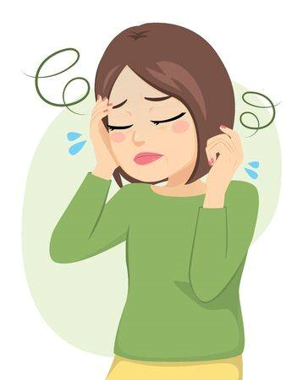


Interventions
time
Intervention
Notes:
Does taking Panadol relieve headaches?

Slide 49
Establishing a correlation
time
time
time
time
time
time
time
time
time
time
time
time
time

Slide 50
Establishing a correlation
Remember we shouldn’t neglect the base rate!
We need to know whether taking Panadol makes it more likely that a person’s headache will be relieved compared to if they didn’t take Panadol.
time
time
time
time
time
time
time
time
time
time
time
time
time
Notes:
Does taking Panadol relieve headaches?

Slide 51
Establishing a correlation
Remember we shouldn’t neglect the base rate!
We need to know whether taking Panadol makes it more likely that a person’s headache will be relieved compared to if they didn’t take Panadol.
x 500
time
x 500
time
Notes:
This might be enough to show a correlation between taking Panadol and headaches being relieved (at least in our samples).
But it’s not enough to establish a causal link – correlation isn’t sufficient for causation!
We need to show that the causal link is the best explanation, so rule out alternative explanations.

Slide 52


Can we rule out alternative explanations of the correlation?
time
Confounding causes?

Slide 53
Controlled trials
Treatment group
time
?
Control group
time
Notes:
We need to rule out other possible explanations, and run a controlled experiment.
Induce headache. Pill, see what proportion of people have their headache relieved.
Control group we hold fixed(“control for”) the potentially confounding causes, but don’t give them the pilll

Slide 54
Controlled trials
Treatment group
time
Control group
time
Notes:
If the proportion of people whose headache is relieved in the treatment group is higher than in the control group, we have evidence that the intervention (Panadol) causes headache relief.

Slide 55
Controlled trials
Treatment group
time
Control group
time
Notes:
If the proportion of people whose headache is relieved in the treatment group is not higher than in the control group, we have shown that the intervention (Panadol) causes headache relief.
We haven’t conclusively shown that Panadol doesn’t cause headache relief, but we have no evidence to think that it does.

Slide 56
What if we don’t know what the possible confounding factors are?

Slide 57



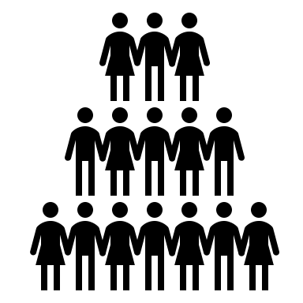





Randomized controlled trials
?
Treatment group
Randomly assigned
?
Control group
Notes:
We can keep all other factors constant while just changing one other variable by randomising our treatment and control groups.
Every person has equal chance of ending up in either group so we know that all potential confounding variables will be distributed in roughly the same way in both groups at the start of the experiment.
Discussion in the reading about blind and double blind randomized controlled trials.

Slide 58
Randomized controlled trials
Compare two large groups of individuals, the treatment group and the control group.
Use randomization to ensure that the two groups are equivalent at the start of the experiment.
Measure the intervention, B, at the start of the experiment.
As far as possible, make sure that everything that happens to the treatment group also happens to the control group except that the treatment group receives the intervention A. (Equal treatment for both groups).
Measure B again at the end of the experiment and compare the two groups.
If B has changed in the treatment group more than it has changed in the control group, you have good evidence that A causes B.
If B has not changed more in the treatment group than in the control group, the experiment has not shown that A causes B.

Slide 59
AT4 Q2 & Exam question
Q2 on your AT4, and one question on your exam will ask you to read an argument and say whether the argument provides a good reason to accept that there is a causal link between A and B.
Is there actually a correlation between A and B?
Is the best explanation for the correlation that A causes B?

